Slide 1
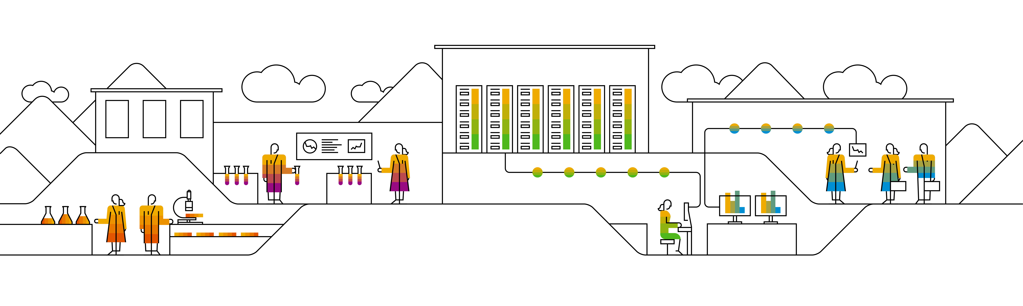
Kubernetes & helm

Slide 2
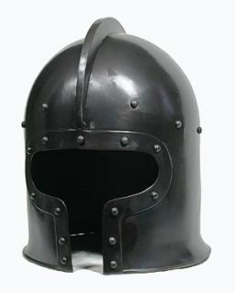

What’s this “helm”?
?
Helm is A Package Manager for Kubernetes
Preconfigured & parameterized packages of Kubernetes resources
Designed to manage applications with several isolated components
Supports “release management” with updates & roll-backs
Initially built by Deis 2015 (a Microsoft company), handed over to CNCF by now

Slide 3
Helm v3 architecture
Client side: helm
Applications are organized in “charts”
Uses kube.config to authorize communication with K8s
Deployed charts are “releases” and have a version
Releases are namespaced
Namespace
Deployment A
Chart
K8s resources
dynamic config
dependencies
helm client
release
“my_app”
Service A
configMap
.kube/ config
Notes:
Helm v3 has only component – the locally running “helm” client. It uses the active available kube.config context to talk to K8s. No separate setup steps are needed.
To use helm, you need the pre-packaged software in so called charts. A chart is a description of how to deploy & parameterize an application. This includes yaml templates for pods, services or configMaps.
Upon installation of the chart, there is a go-templating engine evaluating the given parameters and substituting variables.
In v2, there were two components - the locally running client and the tiller-server. It was required to run “helm init”, to deploy tiller to the cluster. There was also the idea of a global/cluster-wide service to manage all charts installed to a cluster. This idea has been abandoned and helm v3 is a “client-only” tool.
When using helm v2, be careful with namespaces and specify where your tiller-server should run.

Slide 4
Working with helm
Chart repository
- helm repo add <url>
- helm search <chart>
- helm fetch <chart>
Namespace
Deployment A
.kube/ config
helm client
release
“my_app”
Service A
configMap
- helm install <name> <chart> <parameter>
- helm list
- helm status <release>
Notes:
Helm charts can be stored locally or in a repository. The default “stable” repo available in helm v2 has to be added manually with helm v3 (as of now).
Run “helm repo add stable https://kubernetes-charts.storage.googleapis.com/“ to add make it available to your helm installation.
Once the repo is available „helm search repo <term>“ will allow to look for charts. Helm hub (https://hub.helm.sh/) can also be searched with „helm search hub <term>“.

Slide 5
Helm Usage
Add a chart repository
helm repo add stable https://kubernetes-charts.storage.googleapis.com/
# Official repo: https://github.com/helm/charts
List charts
helm search repo mysql
Install a Sample Chart
helm repo update
helm install mydb stable/mysql
List the Releases
helm list

Slide 6
Helm Usage
Release Upgrade
helm upgrade mydb stable/mysql --set imageTag="5.6.0"
Release Rollback
helm rollback mydb 1
Uninstall a Release
Helm uninstall mydb
Value overwrite
helm install mydb stable/mysql -f prod.yaml \
–set mysqlUser=test –set mysqlPassword=test
Create a local chart
helm create myapp

Slide 7
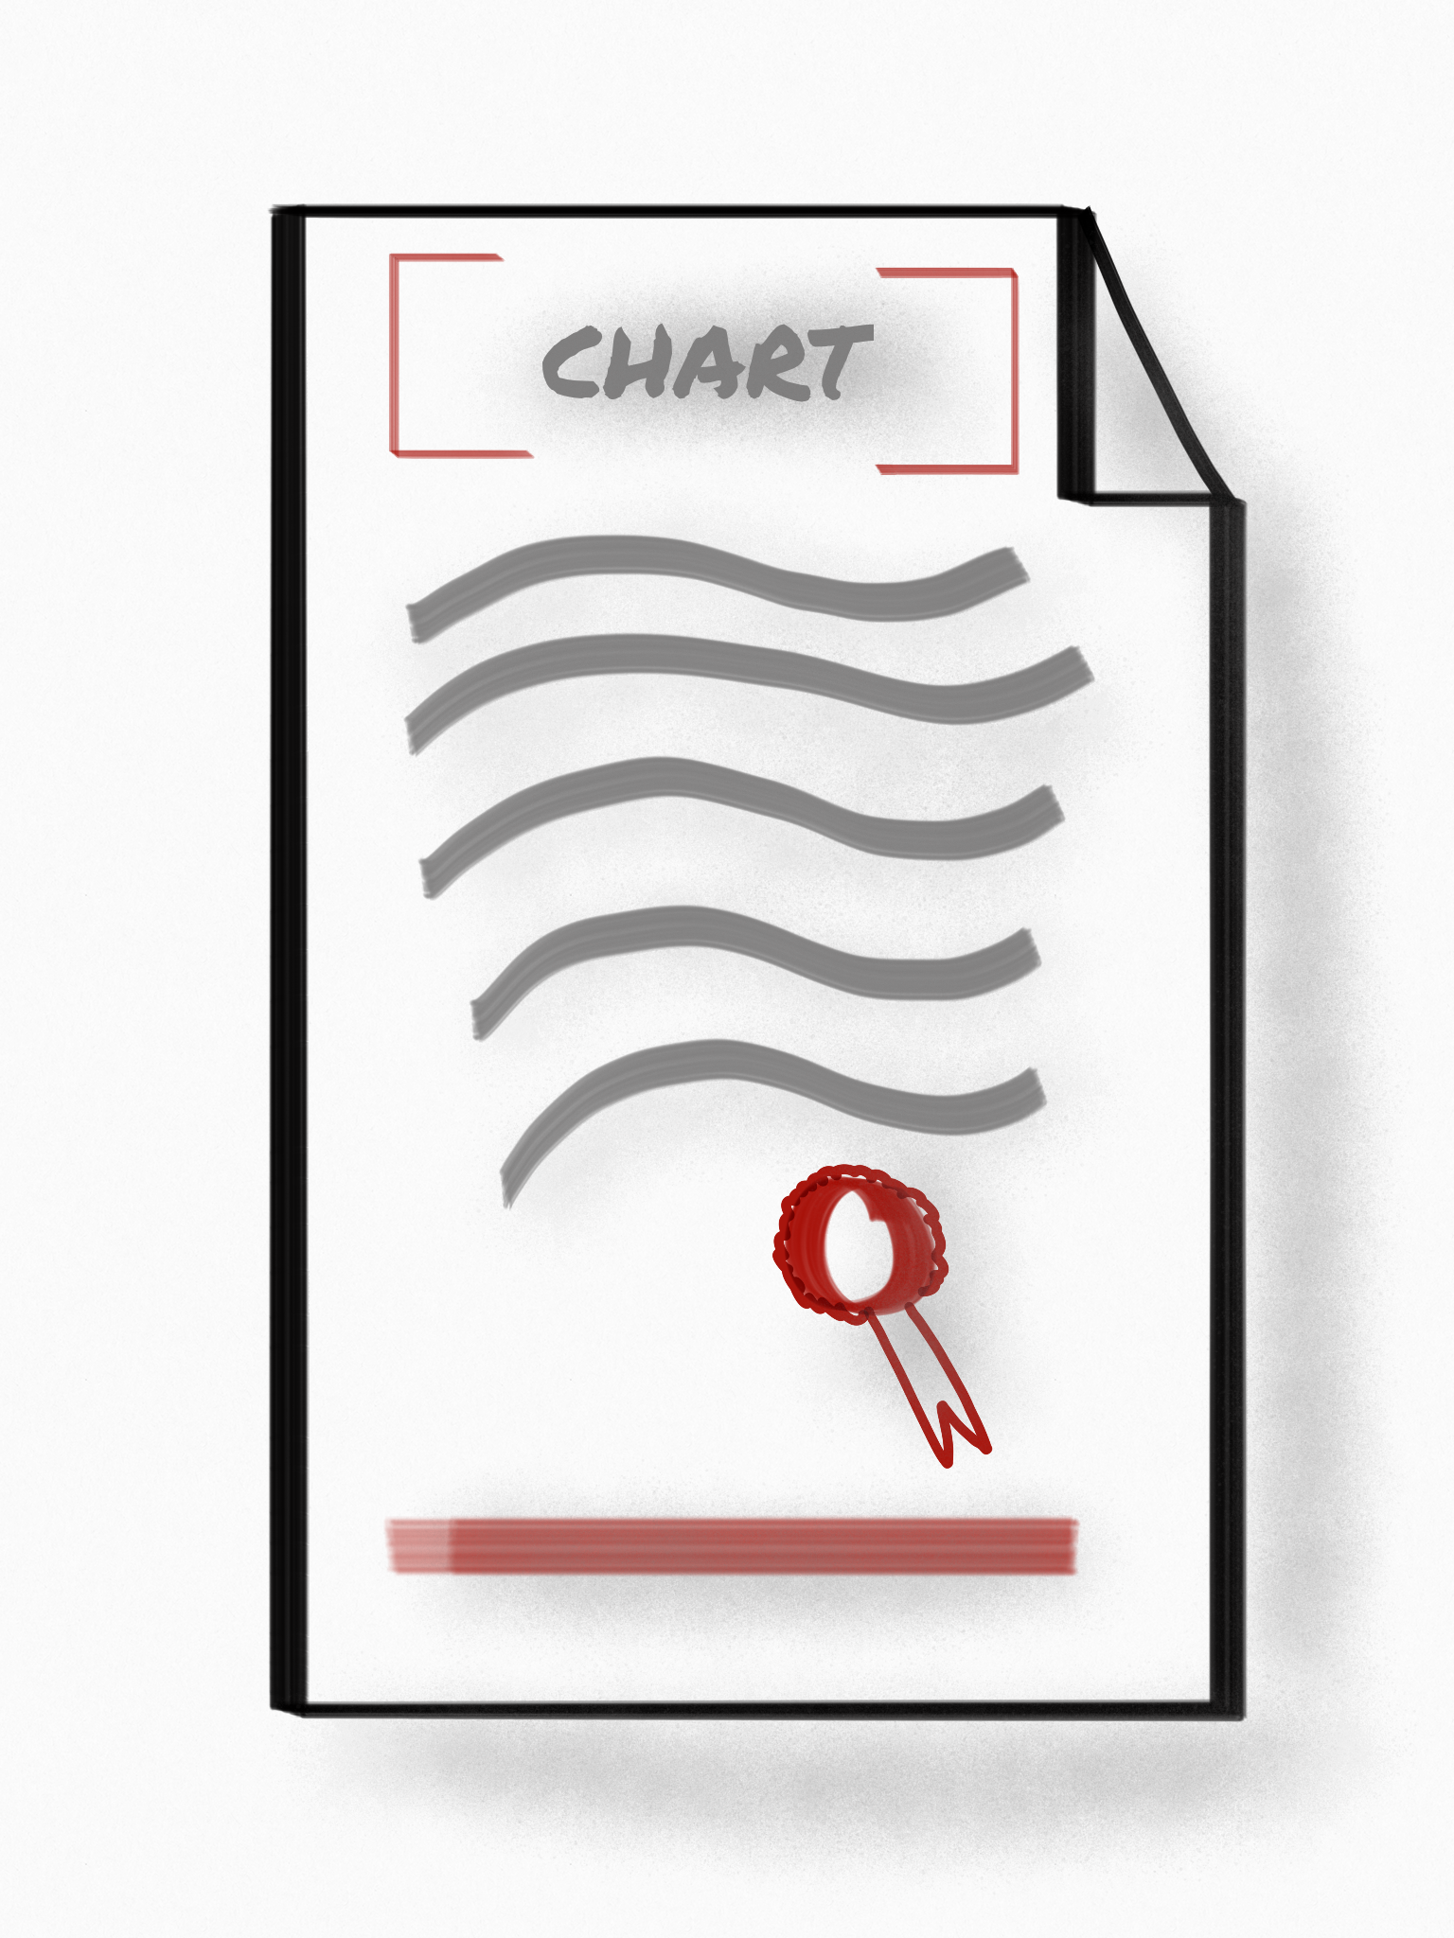
Authoring helm charts
Packages in the helm eco system are called “charts”
wordpress/
Chart.yaml
values.yaml
charts/
templates/
Templates contain variables
Helm renders charts during deployment and substitutes variables with values
https://helm.sh/docs/topics/charts/

Slide 8
Helm charts
Packages of predefined, parameterized K8s resources are called “charts”
wordpress/
Chart.yaml - A file containing information about the chart, incl. dependencies
values.yaml - The default configuration values for this chart
charts/ - A directory containing any charts upon which this chart depends.
templates/ - A directory of templates that, when combined with values, will generate valid Kubernetes manifest files.

Slide 9
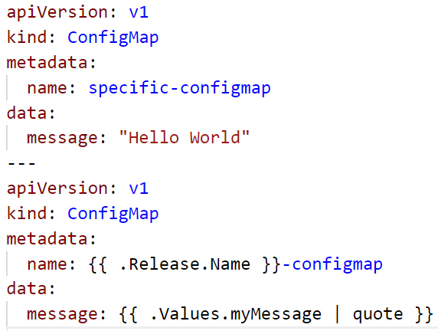
About templates
Simple ConfigMap with specific values
Yaml file needs to be edited each time a change is required
Helm template of a ConfigMap with variables
Variables are converted to specific values upon installation of the chart
Notes:
The power of helm lies within its templates and the ability to convert templates with values into valid yaml files. When authoring charts this is where most of your work will end up.
So lets take a look at the template section of a chart. In our example there are 2 config map yaml files. One is pretty normal and works also without helm. However it is not very flexible. The 2nd file contains references to helm variables – indicated by {{ }}. Helm renders the templates and converts them into valid yaml.
There are build in variables .Release.* and custom values .Values.* . Additionally you can define functions and include / execute them. The definitions are stored in the _helpers.tpl. The demo-chart makes use of these, so take a look around there.
To check, if the chart is ok, use “helm lint”. It will point out yaml errors and much more.
To check, how a chart would actually look like once deployed, use the --dry-run flag in combination with --debug
For details, check https://github.com/kubernetes/helm/tree/master/docs

Slide 10

About (default) values
values.yaml
Most charts come with default values, stored in a values.yaml file in the chart’s direcotry
Values follow the usual yaml structure (indented, maps, lists)
Overwrite default values by specifying the with --set or send a custom values yaml file

Slide 11
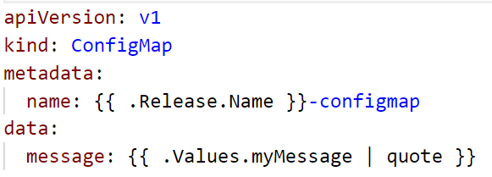
About variables & functions
.Release.* contains build-in variables such as Name
values.yaml
template.yaml
Reference the key in a template to inject the value:
{{ .Values.myMessage }}
Values can be transformed using build-in functions
In the example the injected string will be quoted
Notes:
{{ }} triggers the go templating engine
.Values is a reference to an object with all keys in the values.yaml file
.myMessage is the reference to the key “myMessage” in .Values
In case of nested values such as example below, use .Values.message.greeting or .to to reference the acutal key
message:
greeting: “hello”
to: “course”

Slide 12

Demo
Notes:
Start with showing the helm binary – simply run “helm” without anything else
If not yet done, run a “helm init” to deploy tiller. But probably there is already a tiller from the time when you created the registry.
Show the tiller pod in kube-system namespace. Explain, that for helm init, participants should target their own namespace. Otherwise they will connect to the same tiller. Highlight that in order to setup tiller with cluster access (i.e. outside of it’s namespace a clusterrolebinding is required)
Run “helm list” to show the already installed charts and explain that they are called a “release”.
Next move on to the question, wherefrom to get charts:
Open https://github.com/helm/charts in a browser
Talk about the different “levels” – currently incubator, test & stable and go to stable
Pick up any chart (e.g. mongo db or wordpress) and go into details.
Discuss the info on the readme page, especially the “installing the chart” and “configuration”
Highlight that any parameter in configuration has a default value or is not set.
Highlight that any parameter in configuration can be overwritten / customized either by using “--set key=value” or a values.yaml file.
The default values can be found in the repo in a values.yaml file too.
Go to the templates and take a look at one of the yaml files. Explain that helm uses a go-based engine to render the charts upon deployment ➔ substituting variables with specific values.
Finally run a helm install for the chart you choose and show the created object / run some of the commands printed out.
You can also talk about the --debug (verbosity) & --dry-run (simulation mode) commands for helm actions like install.

Slide 13
Demo
Notes:
Go to the k8s demo folder and continue with demo-chart
Show the content of the template subfolder, starting with the specific-configmap.yaml
Show the flexible-configmap.yaml and explain the build in variables, values references + _helpers.tpl where the functions are defined
Show NOTES.txt -> it contains the lines to print after a successful deployment
Show the values file in the demo-chart folder
Deploy the chart: “helm install .” (assuming your current working directory is ./demo-chart )
run the commands that have been printed by helm
Update the release and change the value of myMessage, use dry-run and debug to double check changes:
helm upgrade --dry-run --debug --set myMessage=“Goodbye course” <release name> .
helm upgrade --set myMessage=“Goodbye course” <release name> .
Update the release with a custom_values.yaml
Helm upgrade –f custom_values.yaml <release name> .
“.” is referencing a relative path to your chart – don’t truncate it!

Slide 14

Exercises #10 & #11

